Slide 1

PROJECT: BLOOD PRESSURE DETECTION FROM PHOTOPLETHYSMORGRAPHY(PPG)SIGNALS
(GROUP III)
Presented By:-
1.Janvi Pangoriya(A1-18)[Group Leader]
2.Kajol Gupta(A1-19)
3.Nidhi Gupta(A2-30)
4.Pranav Tomar(A2-33)

Slide 2
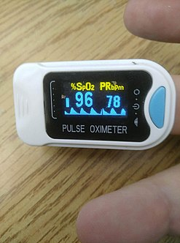
#LEARNING OBJECTIVE
The Ultimate idea of the project is to develop an algorithm which allows us to predict the Blood Pressure using PPG Signals.
Also Identify the Symptoms of cardiac arest caused due to Blood Pressure .
Describe how Hypertension can be measured in the body by using Photoplethysmogram Signals.
Understand the barriers face by patients in control their High Blood Pressure by taking number of samples.

Slide 3
#Motivation
Express Empathy:Empathy is an objective identification with the affective state of another(not his or her experience).
Avoid arguments:By avoiding arguments,the client is more likely to see the healthcare provider as being on his/her side.
Develop Discrepancy(Dissonance): The goal is to elicit the client those aspects of his/her life that are important but may be compromised because of the behaviour.
Roll with Resistance:Ignore antagonistic elements in the client's comments in order to focus on the important underlying issues.
Support self-Efficacy:A person's belief in the possibility of change is an important Motivator.Clients,based on their abilities and the resources and strengths they possess,need to be encouraged by the healthcare provider.

Slide 4
#DATASET
Description of our dataset:
The dataset also includes some information about subjects such as:
Gender , age , height, weight, and body-mass-index(BMI) about the
subject.
The dataset covers :
Individual aged between 21 ad 86 years
Systolic BP levels between 80 and 182 mmHg
Diastolic BP levels between 42 and 107 mmHg
The dataset also covers several different CVDs, including hypertension, cerebral infarction, and insufficient brain blood supply and other related diseases such as diabetes.

Slide 5
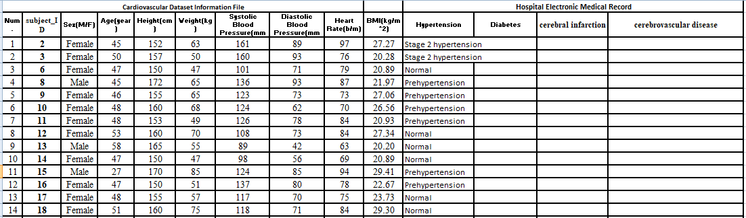
Here is picture our dataset which we are going to use in our project for measuring the blood pressure using PPG signal

Slide 6
#EXPECTED OUTCOME
At the end of the project ,we will be able to give the analytics of the data and prove that data derived from PPG Signals give us enough information to identify the Blood Pressure of the person.
The use of PPG signals as a replacement for cuff-based or invasive BP measurement is relatively new, and most PPG analysis methods are still relatively simple.
Whenever possible, use additional physiological cardiovascular measurements (e.g., ECG etc.) to PPG, in order to increase accuracy.
Motivate the patients to control and manage their Blood Pressure Level.

Slide 7
#APPLICATIONS
Hypertension or high blood pressure is a leading cause of death throughout the world and a critical factor for increasing the risk of serious diseases including heart attack ,stroke and heart failure .So if we could measure the blood pressure beforehand we could easily prevent uncertain death and chaos.
A successful app “Instant Heart Rate” from Azumio uses the cell phone camera and the flash light to measure heart rate. Similarly we could use this algorithm and implement it to analyse the PPG signals and hence report their blood pressures regularly giving them a gesture of regular treatment.

